Slide 1
Lecture 17
Visualize
https://therinspark.com/index.html

Slide 2
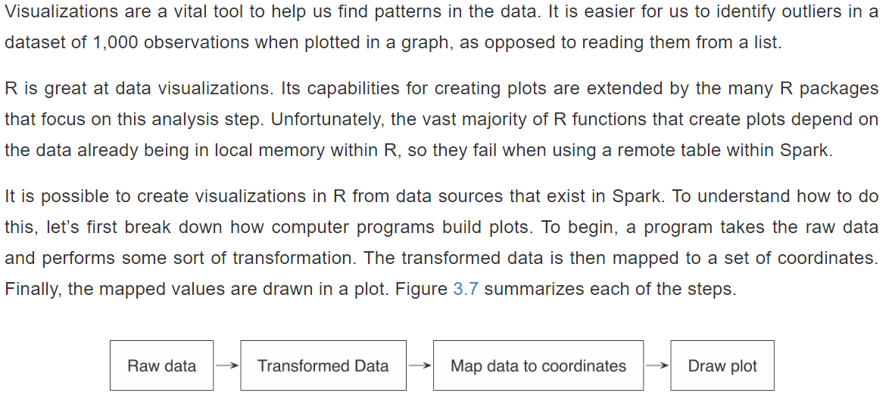

Slide 3
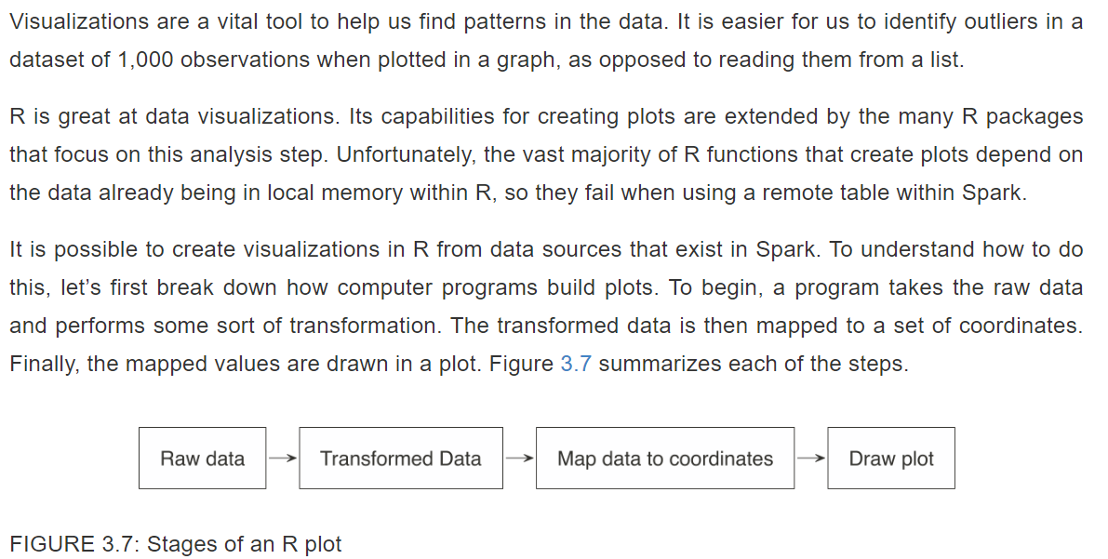

Slide 4
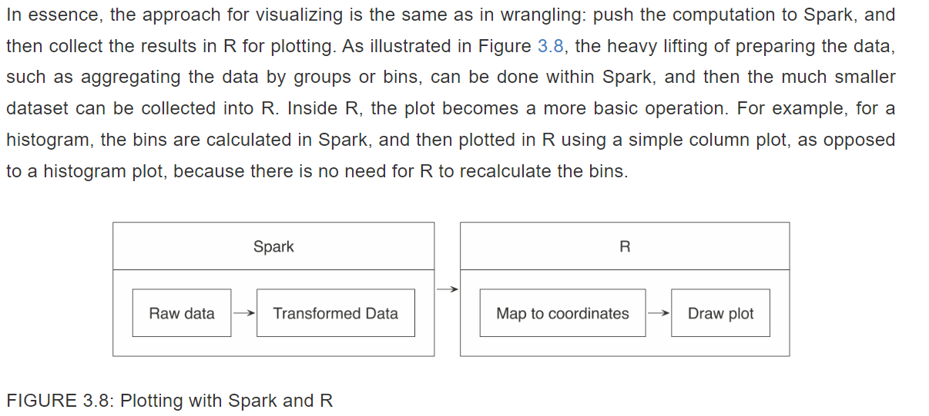

Slide 5
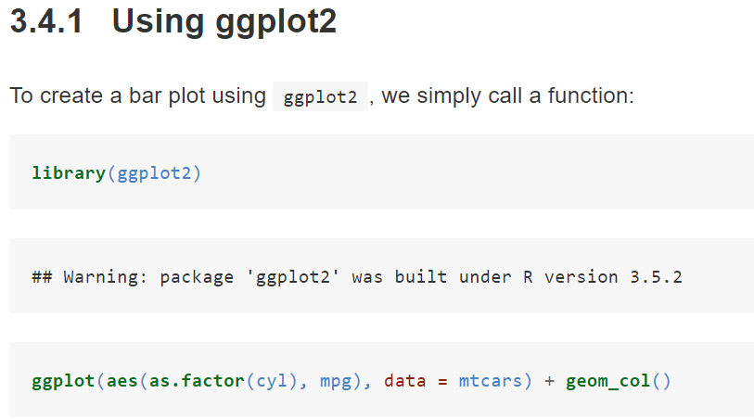

Slide 6
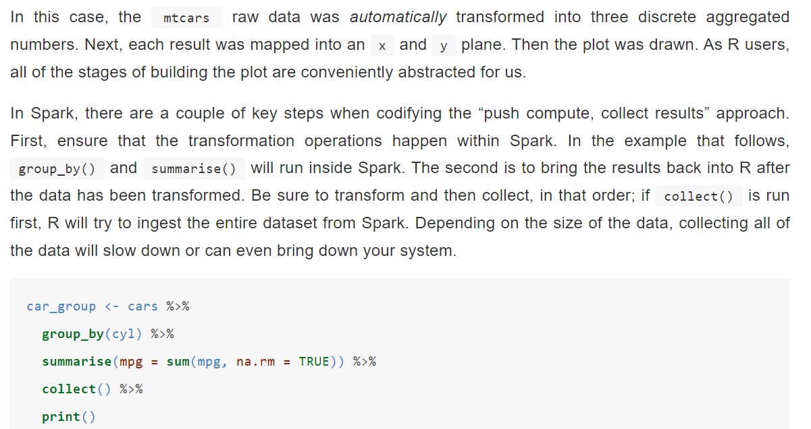

Slide 7
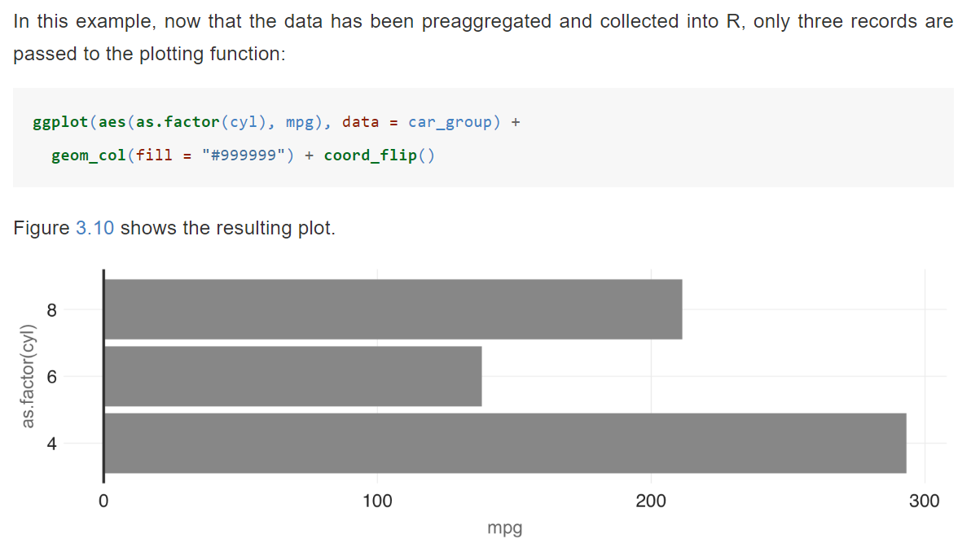

Slide 8
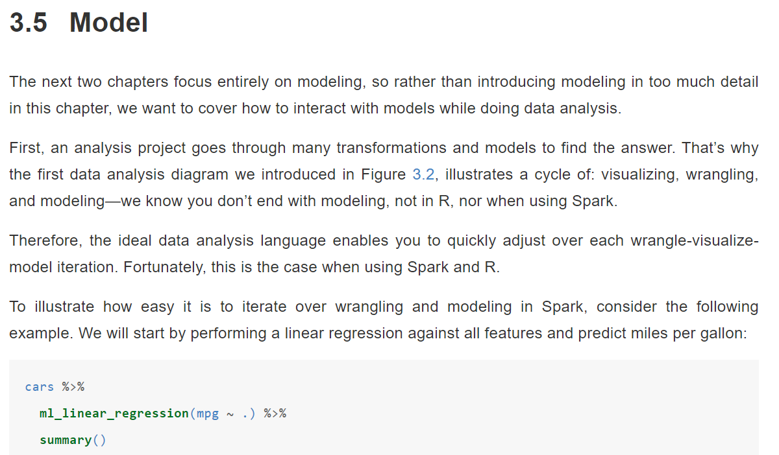

Slide 9
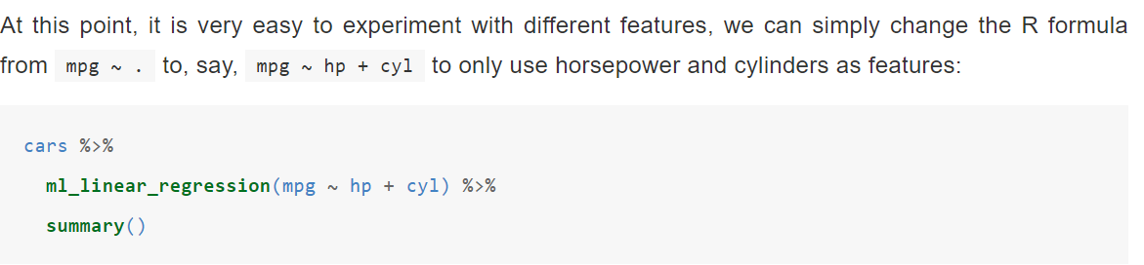

Slide 10
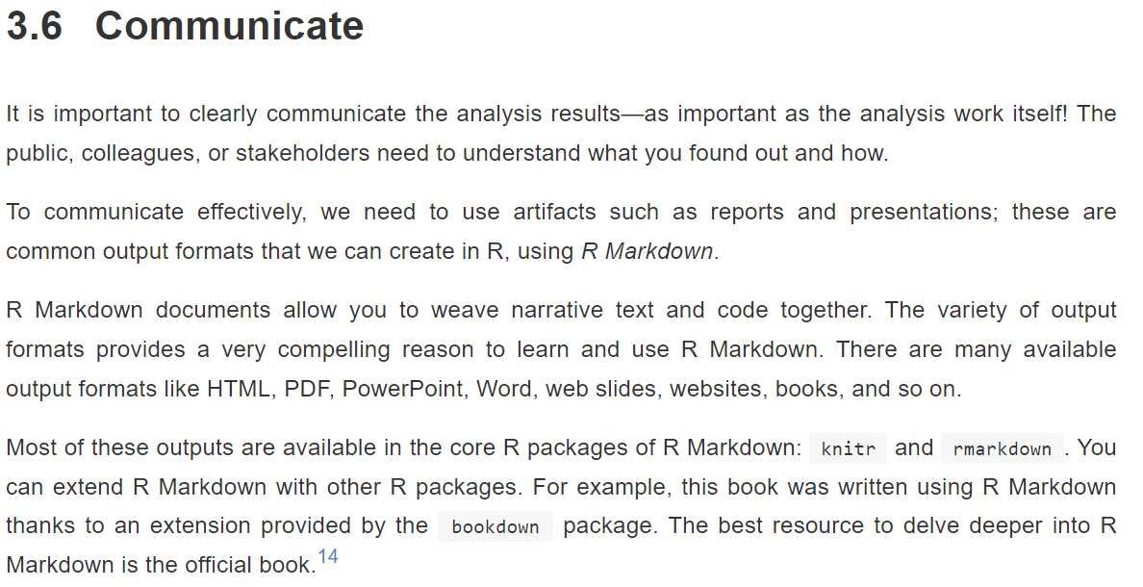

Slide 11
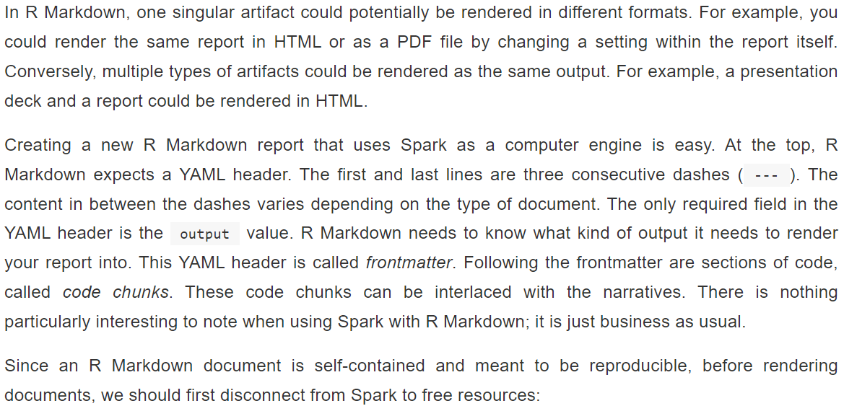

Slide 12
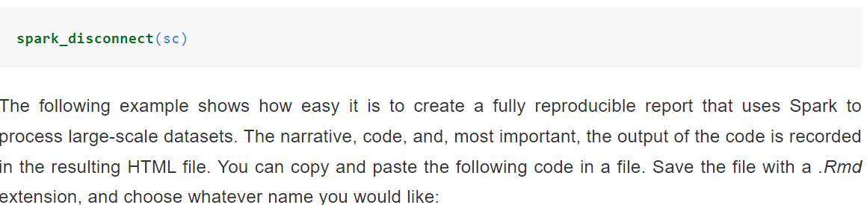

Slide 13
The following example shows how easy it is to create a fully reproducible report that uses Spark to process large-scale datasets. The narrative, code, and, most important, the output of the code is recorded in the resulting HTML file. You can copy and paste the following code in a file. Save the file with a .Rmd extension, and choose whatever name you would like:

Slide 14
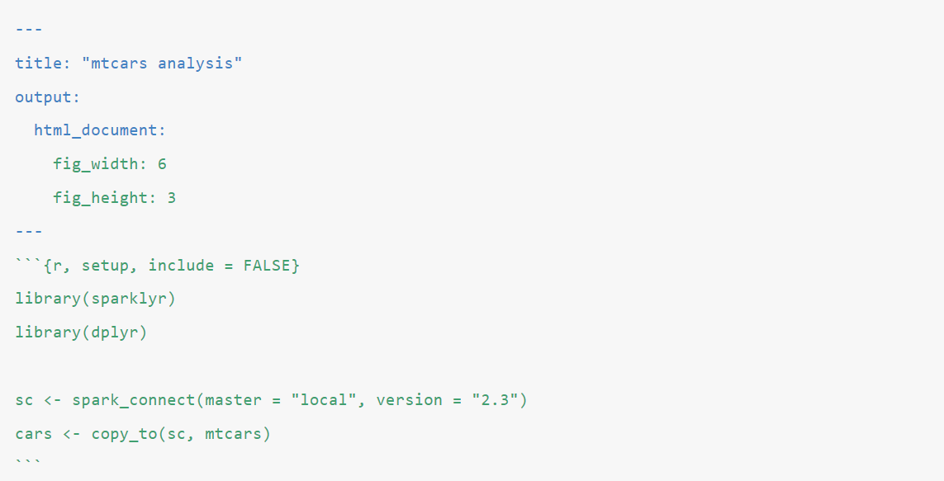

Slide 15
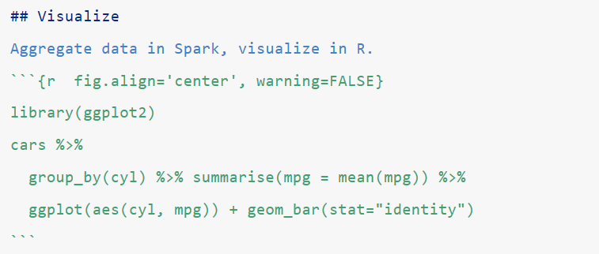

Slide 16
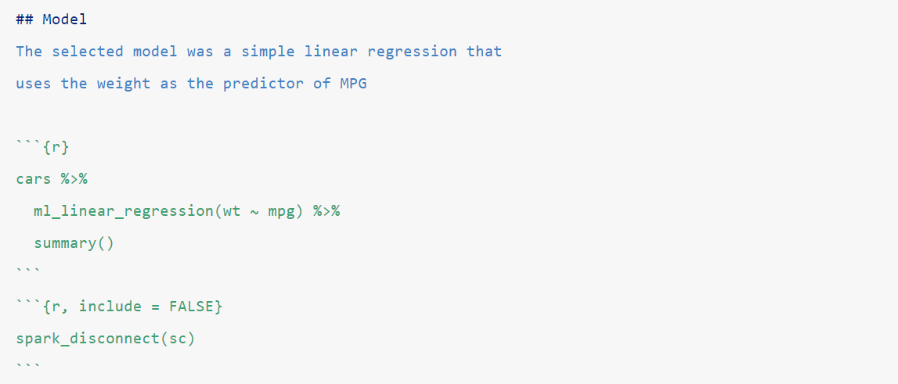

Slide 17
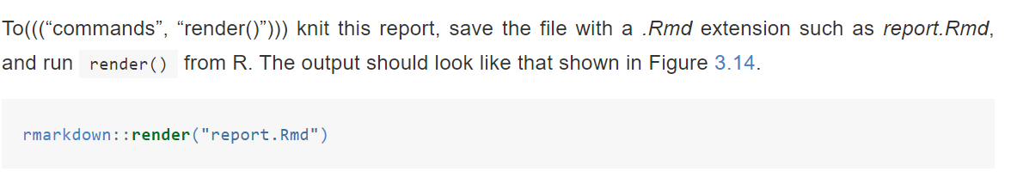

Slide 18
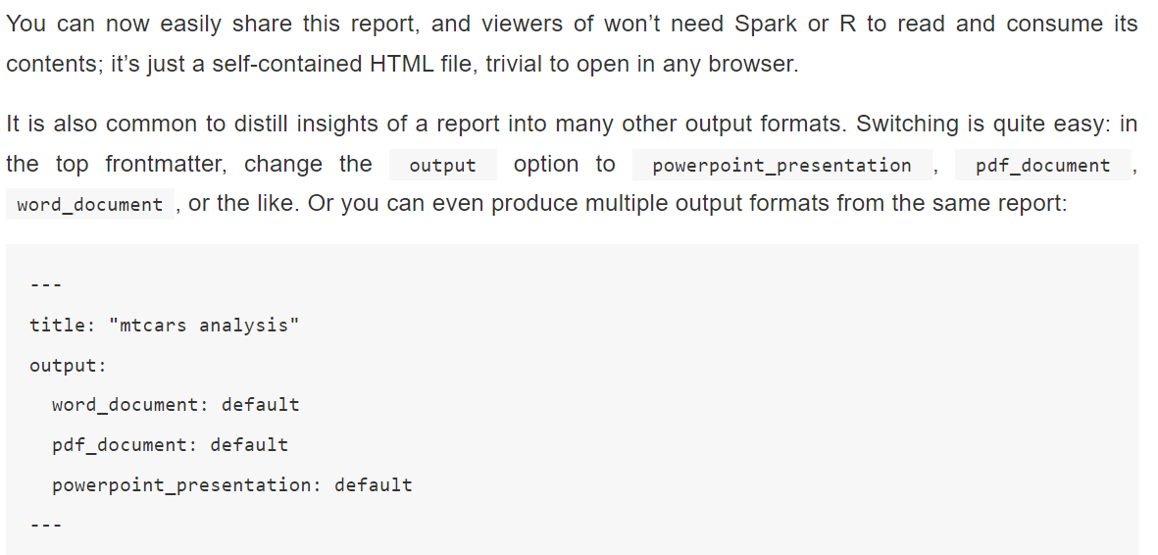

Slide 19
The result will be a PowerPoint presentation, a Word document, and a PDF. All of the same information that was displayed in the original HTML report is computed in Spark and rendered in R. You’ll likely need to edit the PowerPoint template or the output of the code chunks.
This minimal example shows how easy it is to go from one format to another. Of course, it will take some more editing on the R user’s side to make sure the slides contain only the pertinent information. The main point is that it does not require that you learn a different markup or code conventions to switch from one artifact to another.

